Slide 1
Advanced Web Construction
Sajid Rabbani
Senior Software Engineer
Nascenia

Slide 2
Selectors
In CSS, selectors are patterns used to select the element(s) you want to style
Major Selectors –
Element
Class
Id

Slide 3
Selectors
A Class is a name preceded by full stop ‘.’
An ID is a name preceded by hash ‘#’
An ID is used to identify an element just once
A class can be used to identify more than one html element or tag
Important for identifying for CSS & Javascript

Slide 4
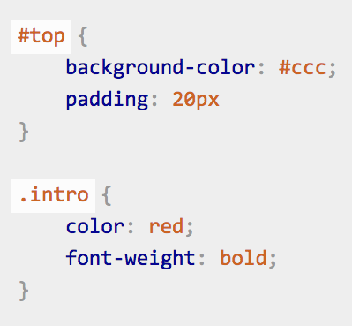
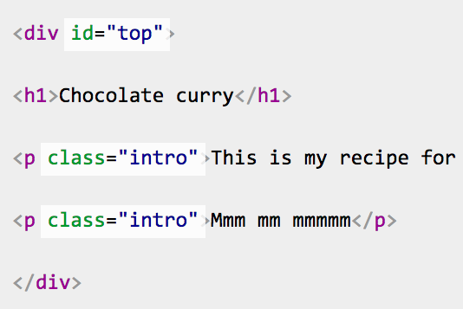
Example of Selectors

Slide 5
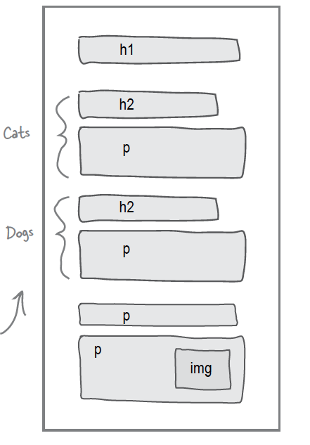
Dividing Page into Logical Sections

Slide 6
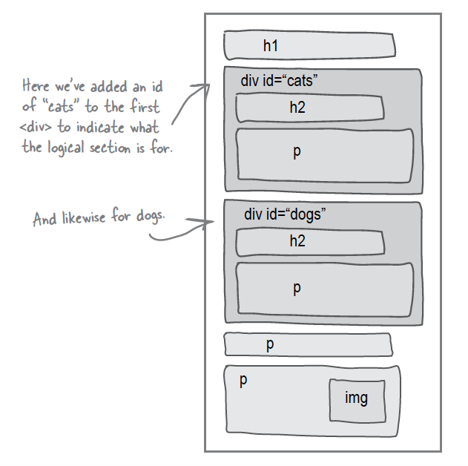
Intro to “div”

Slide 7
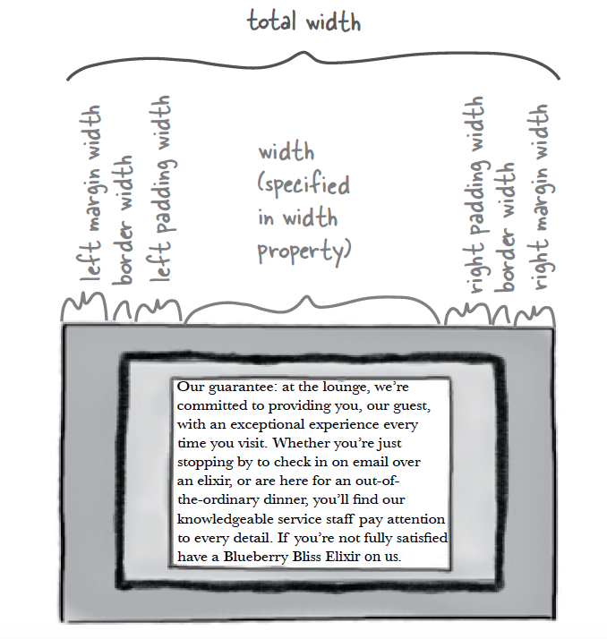
Understanding Margin & Padding

Slide 8
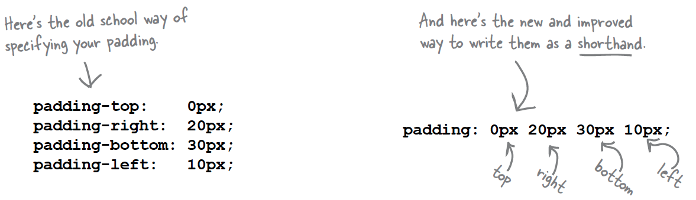
CSS Shortcuts for Margin & Padding

Slide 9
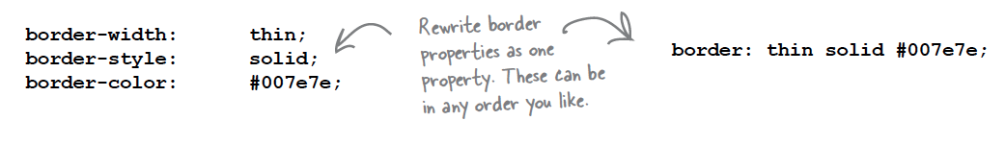
More CSS shortcuts

Slide 10
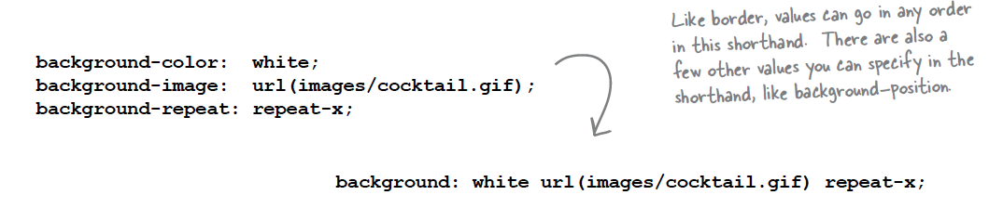
More CSS Shortcuts

Slide 11
Understanding ‘span’
Span gives logically separate inline content

Slide 12
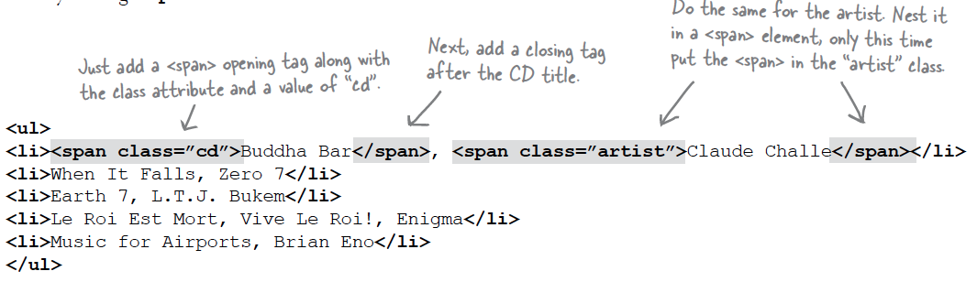
Example of Span

Slide 13
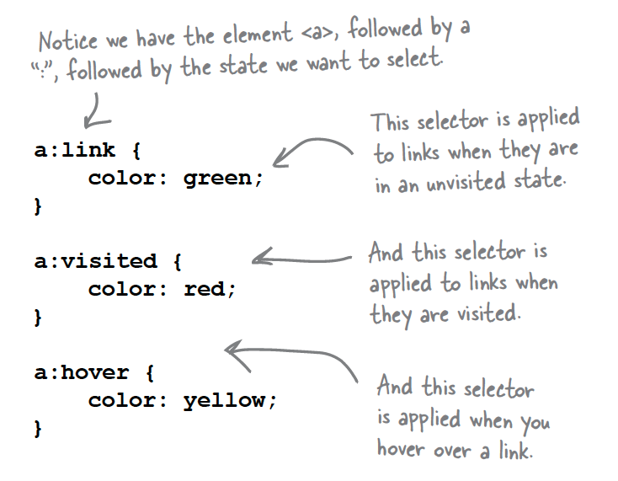
<a> element with Multiple Personalities

Slide 14
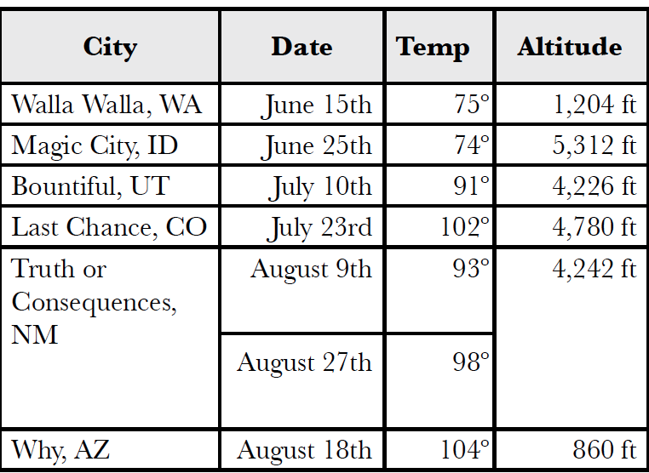
Tables

Slide 15
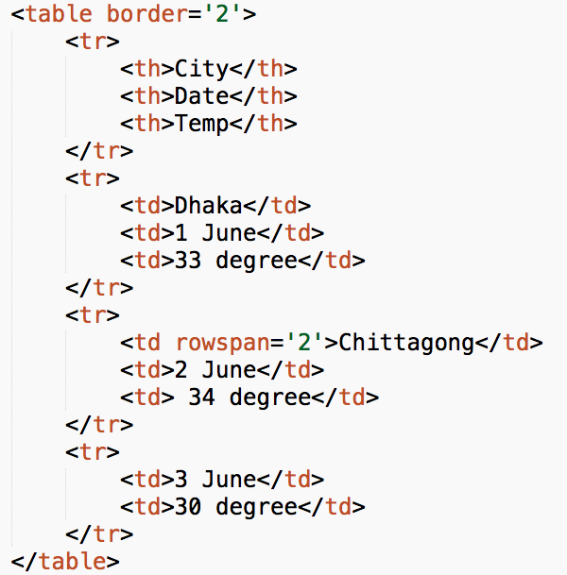
HTML for Table

Slide 16
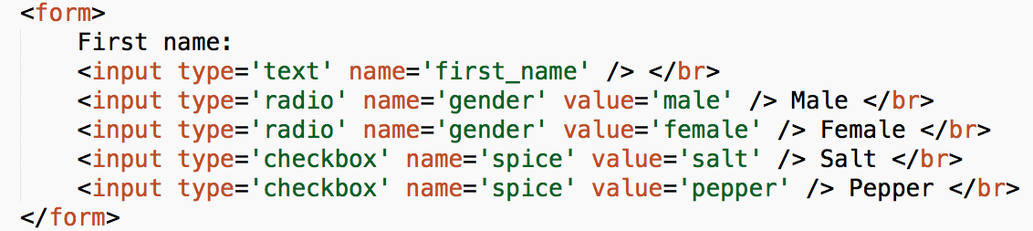
Form & its elements

Slide 17
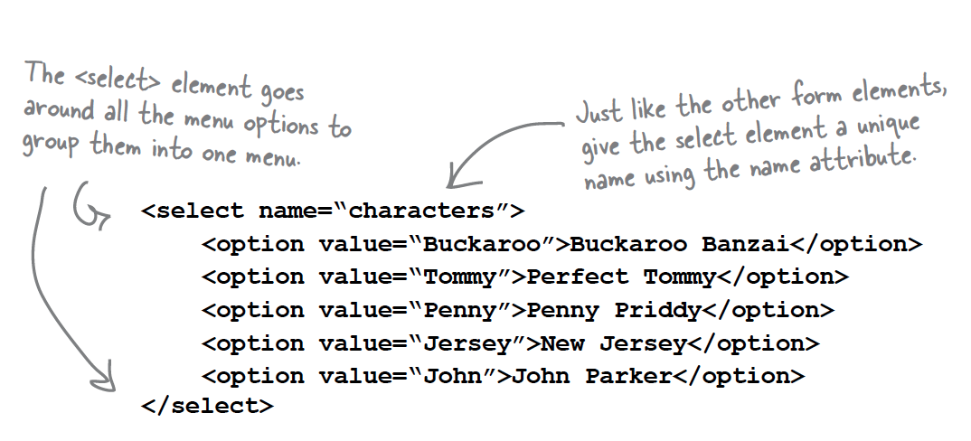
Dropdown

Slide 18
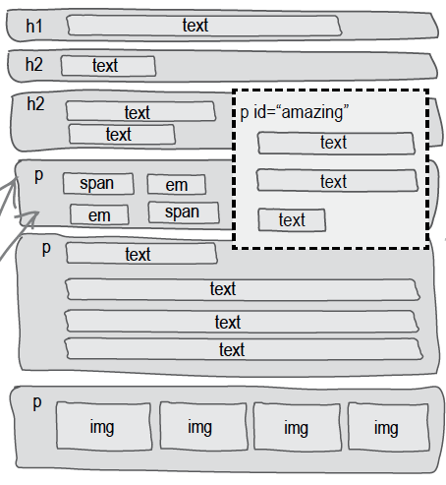
Floating Element

